Slide 1
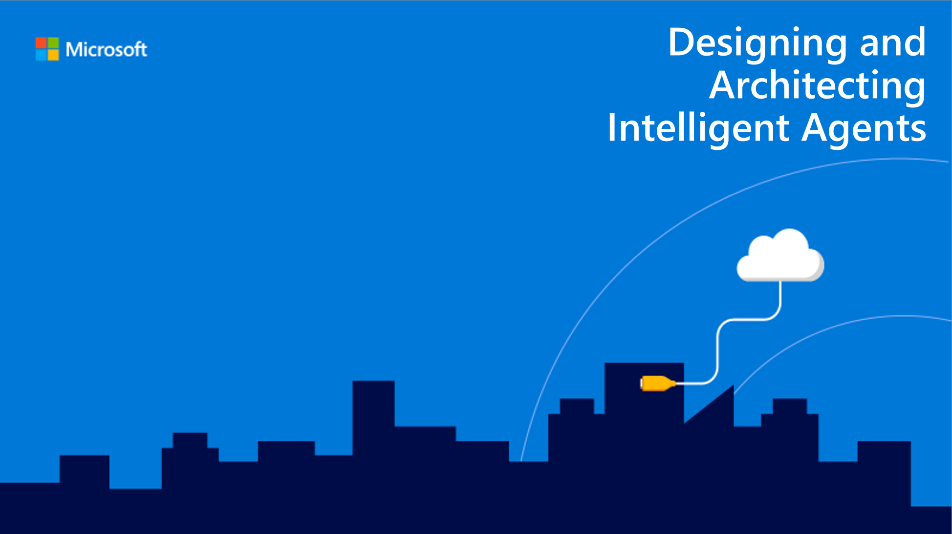
Reference Architectures and Common Patterns
Speaker name

Slide 2
Session objectives and takeaways
At the end of this session, you should be able to…
Articulate the key scenarios for bots and their associated architectures
Explain common patterns for bots and the best practices for dealing with them
Prepare for the release of the new bot framework SDK

Slide 3
Agenda
Key scenarios for bots
Common patterns
New Bot Framework SDK
Notes:
Key scenarios for bots – 10-15 minutes
Common patterns – 5-10 minutes
New Bot Framework SDK – 5-10 minutes
QnA – remaining time

Slide 4
Key scenarios for bots
Cortana
Enterprise Productivity
Information
Internet of Things (IoT)
Commerce
Notes:
Key scenarios for bots: https://docs.microsoft.com/en-us/azure/bot-service/bot-service-scenario-overview

Slide 5
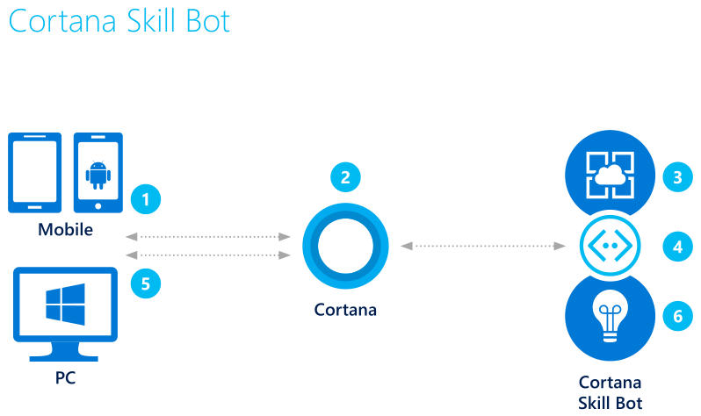
Cortana skills bot
Cortana skills bot
3. Bot accesses user’s calendar and applies logic to the request
Example: Auto appointment
2. Using either text or voice commands, the user asks for an automobile maintenance appointment
1. The user accesses Cortana from their PC or mobile device
4. Queries the auto service for valid appointments
5. Bot presents user with options, user can book appointment
6. Application insights gathers runtime telemetry to help development with bot performance and usage
Key scenarios for bots
Notes:
Cortana skills scenario: https://docs.microsoft.com/en-us/azure/bot-service/bot-service-scenario-cortana-skill
Build a speech-enabled bot with Cortana skills: https://docs.microsoft.com/en-us/azure/bot-service/dotnet/bot-builder-dotnet-cortana-skill
Cortana skills kit: https://docs.microsoft.com/en-us/cortana/skills/overview
Cortana skills samples: https://docs.microsoft.com/en-us/cortana/skills/cortana-samples
Here is the logic flow of a Cortana Skills bot for an auto shop:
The user accesses Cortana from their PC or mobile device.
Using either text or voice commands, the user asks for an automobile maintenance appointment.
Because the bot is integrated with Cortana, it has access to the user's calendar and applies logic to the request.
With that information, the bot can query the auto service for valid appointments.
Presented with contextual options, the user can book the appointment.
Application insights gathers runtime telemetry to help development with bot performance and usage.

Slide 6
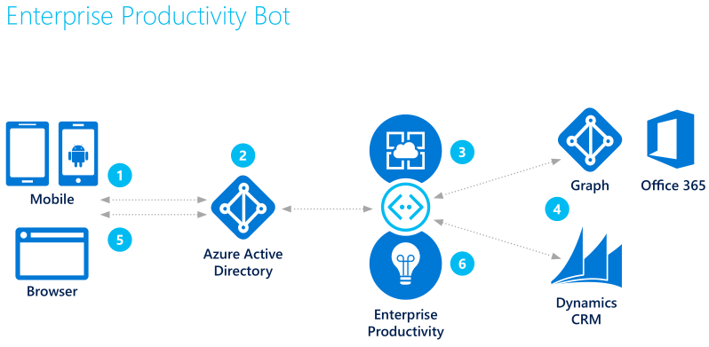
Enterprise Productivity bot
Enterprise Productivity bot
Example: Access other services
3. The bot is able to query the employee’s O365 calendar via Azure Graph
2. AAD validates the employee’s identity
1. The employee accesses the bot
4. Using data gathered from the calendar, the bot accesses case information in Dynamics CRM
5. The information is returned to the employee who can filter down the data from the bot
6. Application insights gathers runtime telemetry to help development with bot performance and usage
Key scenarios for bots
Notes:
Enterprise productivity scenario: https://docs.microsoft.com/en-us/azure/bot-service/bot-service-scenario-enterprise-productivity
Enterprise productivity sample (v3 SDK): https://github.com/Microsoft/AzureBotServices-scenarios/tree/master/CSharp/Enterprise/src
Microsoft Graph: https://graph.microsoft.com/
Another Enterprise bot architecture: https://blogs.msdn.microsoft.com/pragdev/2018/02/10/enterprise-bot-architecture/
UST Global’s Bot Journey: https://customers.microsoft.com/en-us/story/ust-global-professional-services-microsoft-bot-framework-en
Here is the logic flow of an Enterprise Productivity bot:
The employee accesses the Enterprise Productivity bot.
Azure Active Directory validates the employee's identity.
The Enterprise Productivity bot is able to query the employee's Office 365 calendar via the Azure Graph.
Using data gathered from the calendar, the bot accesses case information in Dynamics CRM.
The information is returned to the employee who can filter down the data without leaving the bot.
Application insights gathers runtime telemetry to help development with bot performance and usage.

Slide 7
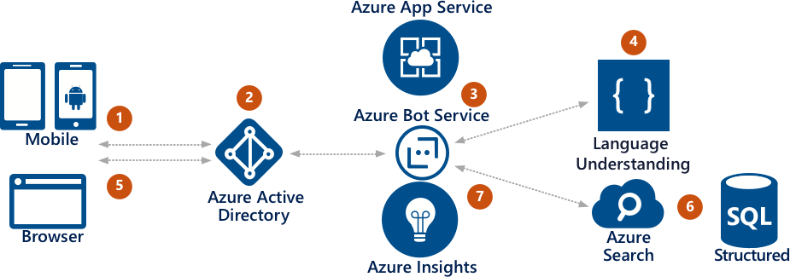
Information bot
Information bot
3. The employee can ask the bot what type of queries are supported
Example: Customer order status
2. AAD validates the employee’s identity
4. Using LUIS or QnA Maker, the bot processes the request and gives answer
1. The employee starts the information bot
5. The employee responds with a valid query
7. Application insights gathers runtime telemetry to help development with bot performance and usage
6. The bot submits the query to Azure Search which returns info from SQL to the user
Key scenarios for bots
Notes:
Information scenario: https://docs.microsoft.com/en-us/azure/bot-service/bot-service-scenario-informational
Information sample (v3 SDK): https://github.com/Microsoft/AzureBotServices-scenarios/tree/master/CSharp/Informational/src
Navitime chatbot to help tourists get around Japan: https://customers.microsoft.com/en-us/story/navitime-japan-travel-hospitality-microsoft-cognitive-services
Fiducia & GAD IT AG using bots for customer services and support: https://customers.microsoft.com/en-us/story/fiducia-gad-cortana-azure-powerbi-services-bot-framework-banking-germany-en
Here is the logic flow of an Information bot:
The employee starts the Information bot.
Azure Active Directory validates the employee's identity.
The employee can ask the bot what type of queries are supported.
Cognitive Services returns a FAQ bot built with the QnA Maker.
The employee defines a valid query.
The bot submits the query to Azure Search which returns information about the application data.
Application insights gathers runtime telemetry to help development with bot performance and usage.

Slide 8
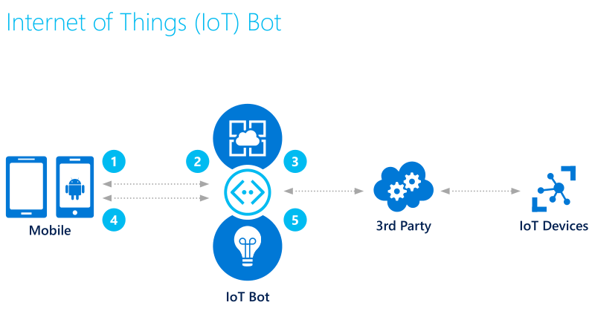
IoT bot
IoT bot
Example: Manage Philips Hue lights
2. Using voice or IM, the user asks the bot to turn on the lights via the IoT device
3. The request is relayed to a third party service that has access to the IoT device network
1. The user logs into Skype to access the IoT bot
4. The results of the command are returned to the user
5. Application insights gathers runtime telemetry to help development with bot performance and usage
Key scenarios for bots
Notes:
IoT scenario: https://docs.microsoft.com/en-us/azure/bot-service/bot-service-scenario-internet-things
IoT sample (v3 SDK): https://github.com/Microsoft/AzureBotServices-scenarios/tree/master/CSharp/Iot/src
IoT solutions: https://www.microsoft.com/en-us/internet-of-things/solutions
Here is the logic flow of an IoT bot:
The user logs into Skype and accesses the IoT bot.
Using voice, the user asks the bot to turn on the lights via the IoT device.
The request is relayed to a 3rd party service that has access to the IoT device network.
The results of the command are returned to the user.
Application insights gathers runtime telemetry to help development with bot performance and usage.

Slide 9
Common patterns
Task automation
Access to knowledge and other content
Bot to human handoff
Bot to web browser and back
Bots in websites
Bots in apps

Slide 10
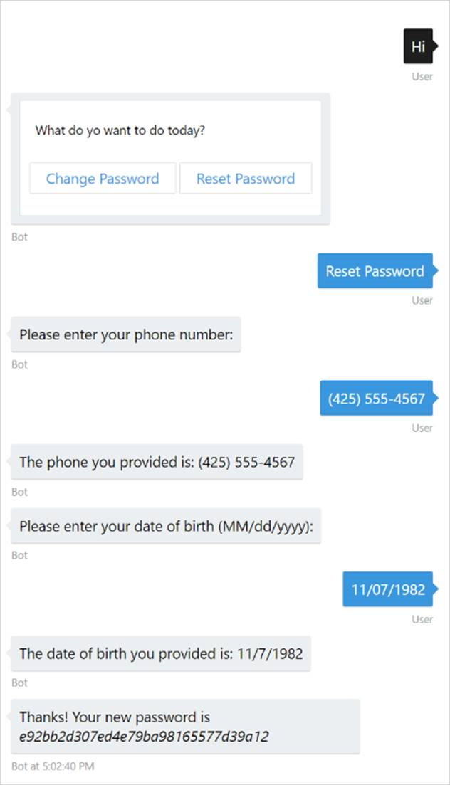
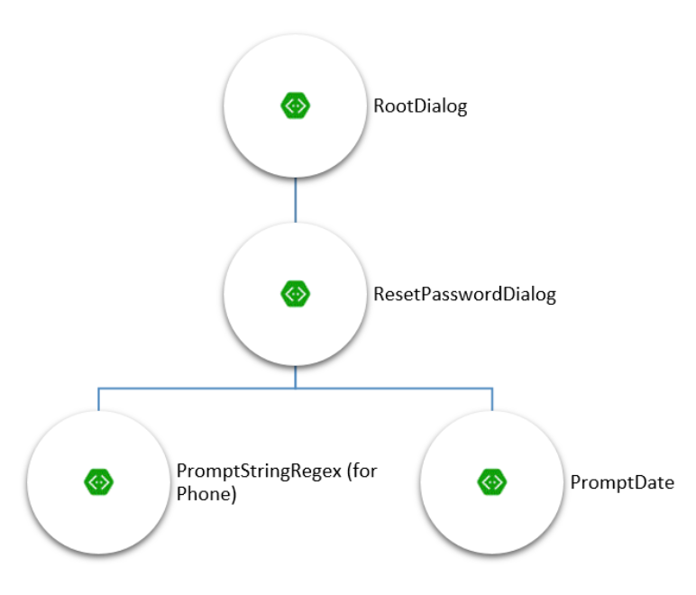
Task automation
Task automation
Example: password-reset
Common patterns
Notes:
Task automation documentation: https://docs.microsoft.com/en-us/azure/bot-service/bot-service-design-pattern-task-automation
Simple task automation sample (C# v3 SDK): https://github.com/Microsoft/BotBuilder-Samples/tree/master/CSharp/capability-SimpleTaskAutomation
Simple task automation sample (Node.js v3 SDK): https://github.com/Microsoft/BotBuilder-Samples/tree/master/Node/capability-SimpleTaskAutomation

Slide 11
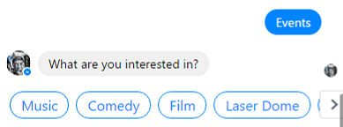
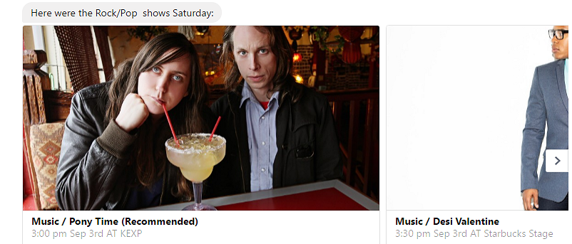
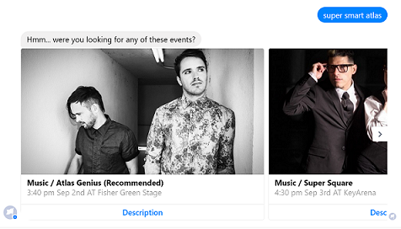
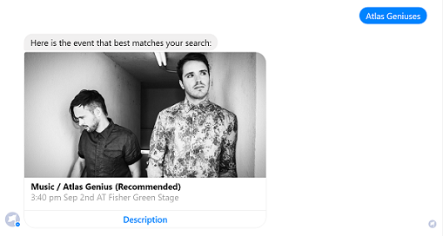
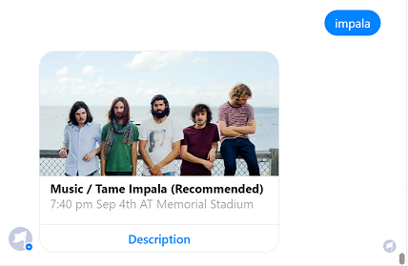
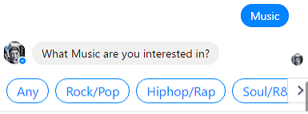
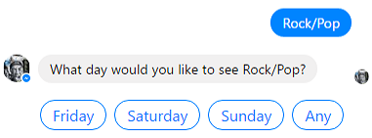
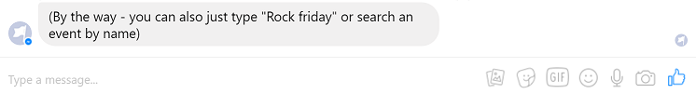
Access to knowledge and other content
Access to knowledge and other content
Azure Search
QnA Maker
LUIS
Bing APIs
Microsoft Graph
Common patterns
Notes:
Azure search: https://azure.microsoft.com/en-us/services/search/
QnA maker: https://www.microsoft.com/cognitive-services/en-us/qnamaker
Bootcamp Materials - Combing LUIS and Azure Search in Microsoft Bot Framework SDK v4 for .NET: https://github.com/Azure/LearnAI-Bootcamp/blob/master/emergingaidev_bootcamp.md
Search-powered bots sample (v3 SDK): https://github.com/Microsoft/BotBuilder-Samples/tree/master/CSharp/demo-Search
Knowledge bot sample (v3 SDK): https://github.com/Microsoft/BotBuilder-Samples/tree/master/CSharp/sample-KnowledgeBot
QnA maker library for v4 SDK (.NET): https://github.com/Microsoft/botbuilder-dotnet/tree/master/libraries/Microsoft.Bot.Builder.Ai
Using LUIS and QnA maker with the v4 SDK: https://github.com/Microsoft/botbuilder-dotnet/wiki/Using-LUIS-and-QnA-Maker
Bing Search APIs: https://azure.microsoft.com/en-us/services/cognitive-services/directory/search/
Microsoft Graph: https://developer.microsoft.com/en-us/graph
Samples for integrating Microsoft Graph with .NET: https://github.com/search?q=aspnet+sample+user:microsoftgraph&type=Repositories

Slide 12
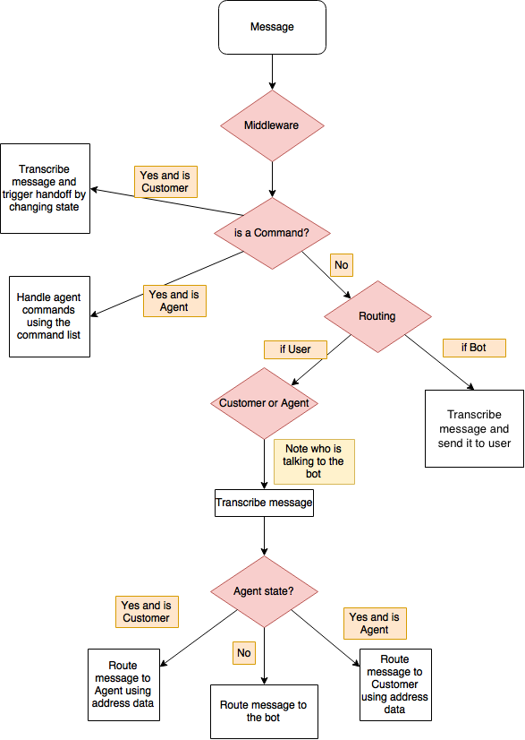
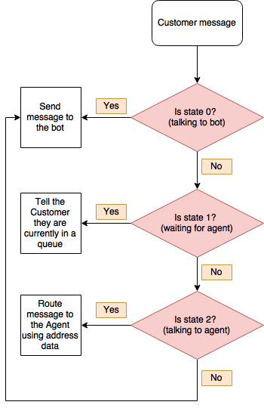
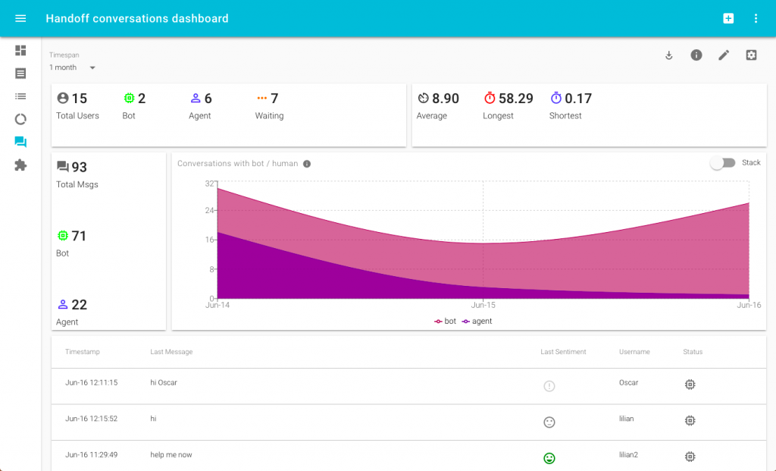
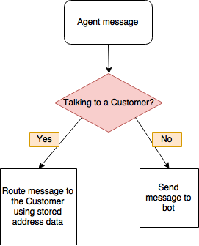
Bot to human handoff
Scenarios
Triage
Escalation
Supervision
Transitioning control
Routing messages between user and agent
Common patterns
Notes:
Transition conversations from bot to human: https://docs.microsoft.com/en-us/azure/bot-service/bot-service-design-pattern-handoff-human
Bot to human handoff in Node.js: https://www.microsoft.com/developerblog/2017/06/30/bot-to-human-handover-in-node-js/
Analyzing bot to human handoff interactions: https://www.microsoft.com/developerblog/2018/02/05/human-handoff-dashboard/
Bot handoff sample code and implementation instructions (Node.js): https://github.com/palindromed/Bot-HandOff
Botbuilder-handoff npm module: https://www.npmjs.com/package/botbuilder-handoff

Slide 13
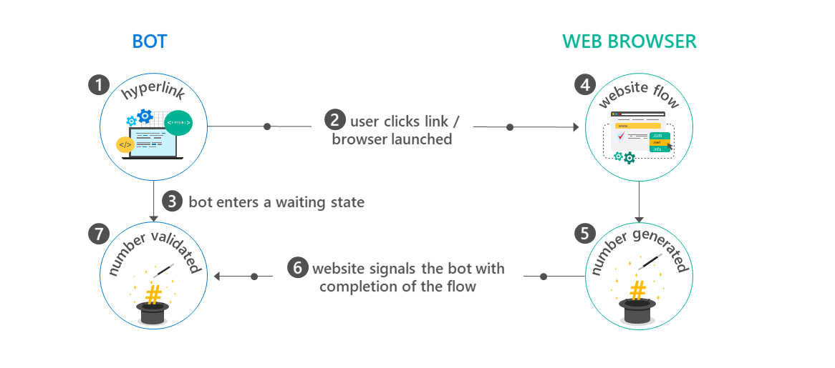
Bot to web browser and back
Bot to web browser and back
WARNING:
Transitioning from chat to web browser and back is not ideal, as switching between applications can easily confuse a user. To provide a better experience, many channels offer built-in HTML windows that a bot can use to present applications would otherwise appear in a web browser. This technique allows the user to remain within the conversation while still accessing external resources. This approach is conceptually similar to mobile applications managing authorization flows using OAuth within embedded web views.
Common patterns
Notes:
Bot to web documentation: https://docs.microsoft.com/en-us/azure/bot-service/bot-service-design-pattern-integrate-browser
Bot Authentication samples (v3 SDK): https://github.com/MicrosoftDX/botauth
Example of bot to web browser for authentication: https://blogs.msdn.microsoft.com/uk_faculty_connection/2016/06/17/developing-a-microsoft-health-bot-based-on-data-captured-from-the-microsoft-band/
Authentication library for the v4 SDK (.NET): https://github.com/Microsoft/botbuilder-dotnet/tree/master/libraries/Microsoft.Bot.Connector/Authentication
Authentication library for the v4 SDK (Node.js): https://github.com/Microsoft/botbuilder-js/tree/master/libraries/botframework-connector/lib/auth
Consider each step of the flow:
The bot generates and displays a hyperlink that will redirect the user to a website. The hyperlink typically includes data via querystring parameters on the target URL that specify information about the context of the current conversation, such as conversation ID, channel ID, and user ID in the channel.
The user clicks the hyperlink and is redirected to the target URL within a web browser.
The bot enters a state awaiting communication from the website to indicate that the website flow is complete.
Tip
Design this flow so that the bot will not permanently remain in the 'waiting' state if the user never completes the website flow. In other words, if the user abandons the web browser and starts communicating with the bot again, the bot should acknowledge, not ignore that input.
The user completes the necessary task(s) via the web browser. This could be an OAuth flow or any sequence of events required by the scenario at hand.
When the user completes the website flow, the website generates a ‘magic number’ and instructs the user to copy the value and paste it back into the conversation with the bot.
The website signals to the bot that the user has completed the website flow. It communicates the 'magic number' to the bot and provides any other relevant data. For example, in the case of an OAuth flow, the website would provide an access token to the bot.
The user returns to the bot and pastes the 'magic number' into the chat. The bot validates that 'magic number' provided by the user matches the expected value, verifying that the current user is the same user who previously clicked the hyperlink to initiate the website flow.

Slide 14
Bots in websites
Bots in websites
Embed a bot in a website
Skype web control
Open source web control
Using the backchannel mechanism
Direct Line API
Common patterns
Notes:
Bots in websites documentation: https://docs.microsoft.com/en-us/azure/bot-service/bot-service-design-pattern-embed-web-site
Open source web chat: https://github.com/Microsoft/BotFramework-WebChat
Using the backchannel mechanism (Node.js): https://docs.microsoft.com/en-us/azure/bot-service/nodejs/bot-builder-nodejs-backchannel
Connect directly to bots with the Direct Line API: https://docs.microsoft.com/en-us/azure/bot-service/rest-api/bot-framework-rest-direct-line-3-0-concepts
How to enable bots for Direct Line: https://docs.microsoft.com/en-us/azure/bot-service/bot-service-channel-connect-directline

Slide 15
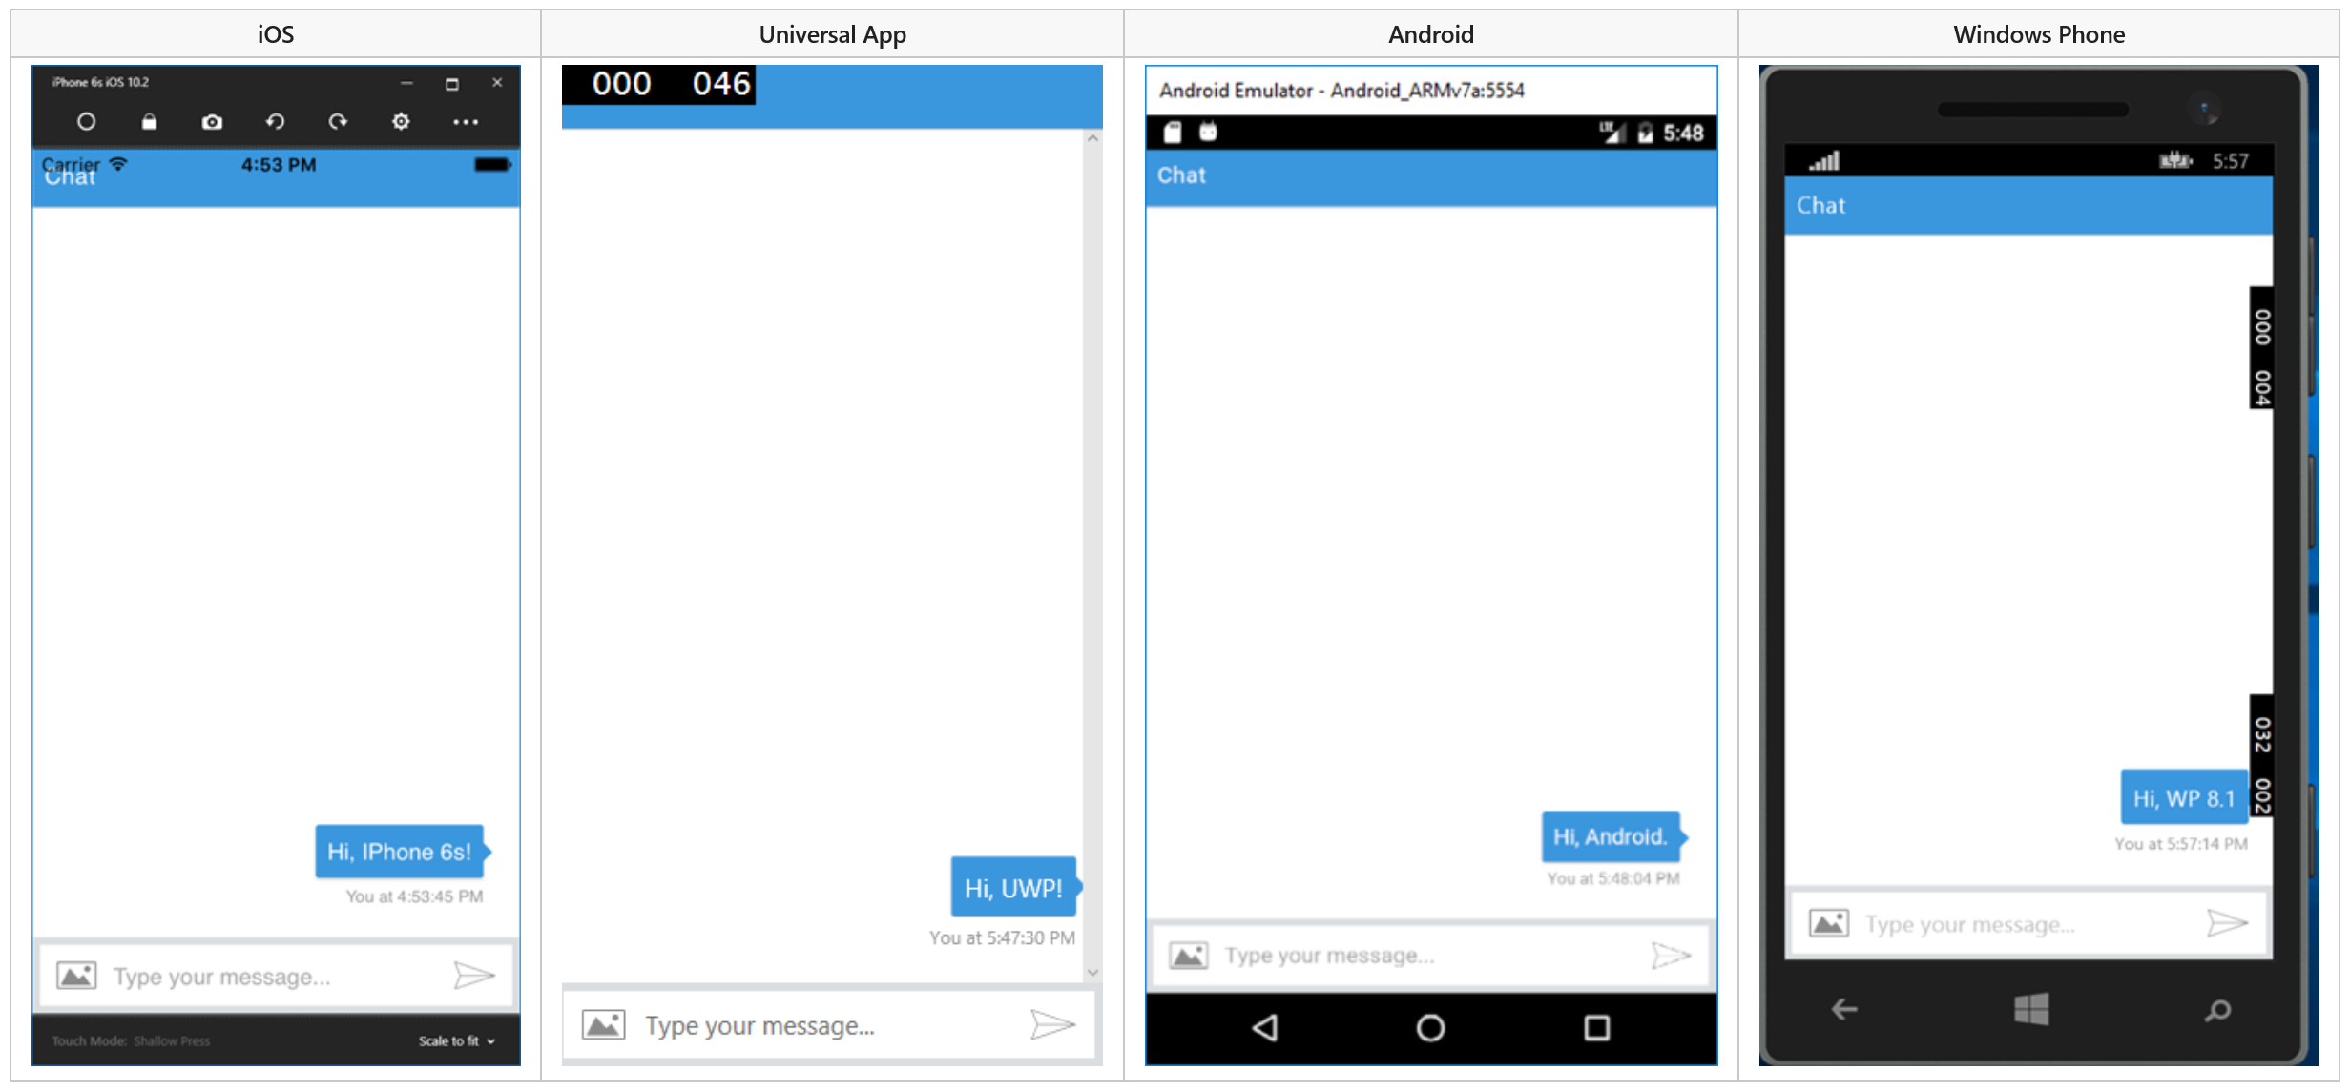
Bots in apps
Bots in apps
Common patterns
Notes:
Bots in apps documentation: https://docs.microsoft.com/en-us/azure/bot-service/bot-service-design-pattern-embed-app
Bots in apps sample (v3 SDK): https://github.com/Microsoft/BotBuilder-Samples/tree/master/CSharp/capability-BotInApps
Use open source web chat control: https://github.com/Microsoft/BotFramework-WebChat
For native mobile apps, IoT apps, and other types of apps/games use the Direct Line API: https://docs.microsoft.com/en-us/azure/bot-service/rest-api/bot-framework-rest-direct-line-3-0-concepts

Slide 16
New Bot Framework SDK v4
V3 SDK issues
V4 SDK goals
V4 SDK architecture

Slide 17
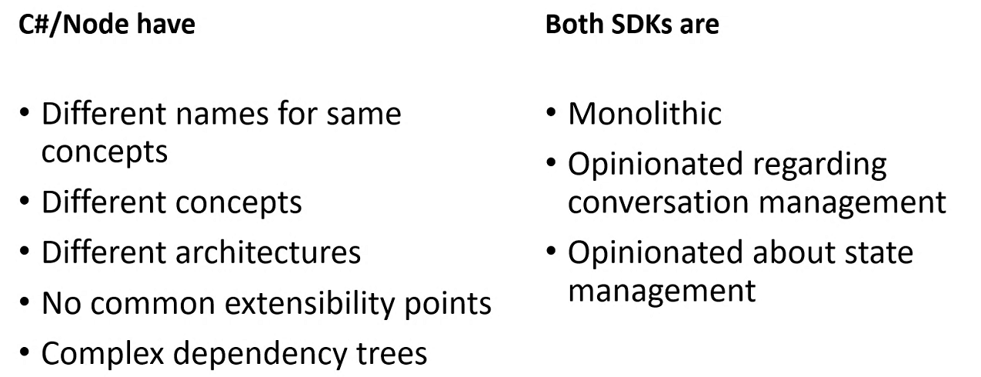
V3 SDK issues
V3 SDK issues
Bot Framework v4

Slide 18
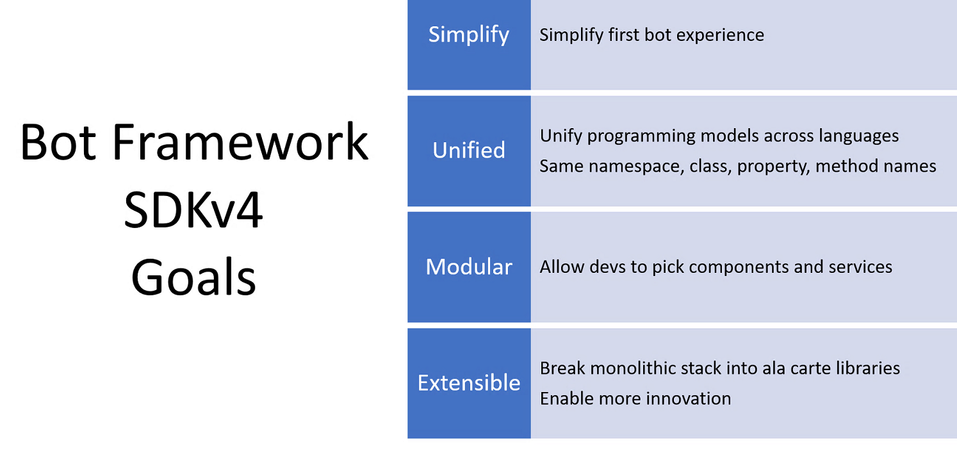
V4 SDK goals
V4 SDK goals
Bot Framework v4

Slide 19
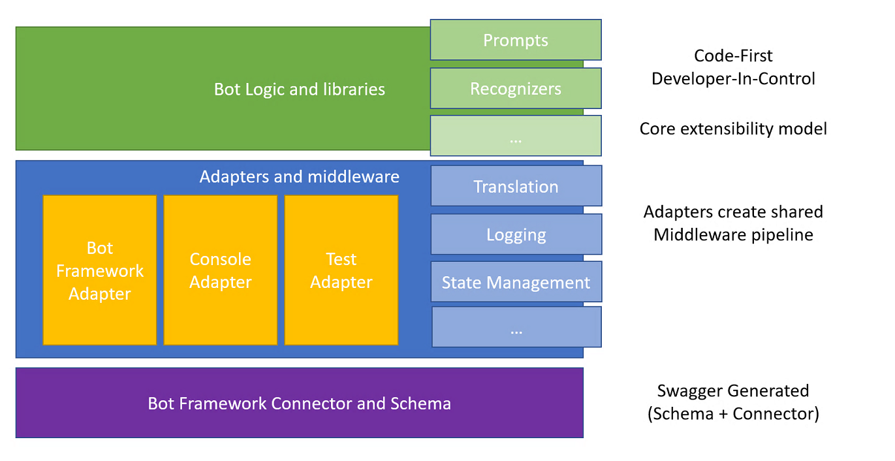
V4 SDK architecture
V4 SDK architecture
Bot Framework v4
Notes:
Node.js: https://github.com/Microsoft/botbuilder-js
.NET: https://github.com/Microsoft/botbuilder-dotnet
Python: https://github.com/Microsoft/botbuilder-python
Java: https://github.com/Microsoft/botbuilder-java

Slide 20
Additional resources
The full Learn AI Bootcamp: https://github.com/Azure/LearnAI-Bootcamp
Our team: http://learnanalytics.microsoft.com/
AI Learning Paths: https://aischool.microsoft.com/learning-paths
Notes:
Use this slide to share additional content available that attendees should know about. In this section you can call out whitepapers or websites that you and your team have created.

